Slide 1
Module 1 Fundamentals of the analysis of algorithms
Fundamentals of the analysis of algorithms
Time and Space complexity,
Asymptotic analysis and notation,
Best,average and worst-case analysis,
Recurrences: The substitution method, Recursive tree method, Masters method.

Slide 2
Algorithm
An algorithm is a step-by-step procedure (blueprint) to solve a problem.
It is an effective procedure for solving a problem in finite number of steps. That is, a well-defined algorithm always provides an answer and is guaranteed to terminate.
A good algorithm should be optimized in terms of time and space.
Different types of problems require different types of algorithmic-techniques to be solved in the most optimized manner.
Algorithms are mainly used to achieve software re-use.

Slide 3
Characteristics of Algorithm
Definiteness: Steps are precisely defined and actions to be carried out must be rigorously and unambiguously specified for each case.
Finiteness : Algorithm should terminate after a finite number of steps.
Input : Algorithm should receive 0 or more inputs.
Output: Algorithm should produce at least one output.
Generality: Algorithm should be applicable to a set of inputs.
Unambiguous: Algorithm should be clear and unambiguous
Independent: of any programming language.
Feasibility: should be feasible with available resources.

Slide 4
Difference between Algorithm and Program
Sr. No. | Algorithm | Program
1. | Written at design phase of SDLC | Written at implementation phase of SDLC
2. | Person writing algorithm should have domain knowledge | Programmer writing the program may or may not have domain knowledge.
3. | Any language can be used to write algorithm. E.g English, mathematical notations etc. | Programming Language
4. | H/W and S/W(OS) Independent | Dependent
5 | Analyze the algorithm | Testing of Program.

Slide 5
Types of Algorithms
Brute Force Algorithm: Technically it is just like iterating every possibility available to solve that problem.
Recursive Algorithm: -- This type of algorithm is based on recursion.
Examples: Factorial of a Number, Fibonacci Series , Tower of Hanoi, DFS for Graph, etc.
Divide and Conquer Algorithm: -- In Divide and Conquer algorithms, the idea is to solve the problem in two sections, the first section divides the problem into sub problems of the same type. The second section is to solve the smaller problem independently and then add the combined result to produce the final answer to the problem
Examples: Binary Search, Merge Sort, Quick Sort, Stassen's Matrix Multiplication, etc.

Slide 6
Types of Algorithms
Greedy Algorithm(Optimization problems): -- In the Greedy Algorithm, the solution is built part by part. The decision to choose the next part is done on the basis that it gives the immediate benefit. It never considers the choices that had taken previously.
Examples: Prim’s Algorithm, Kruskal’s Algorithm, Huffman Coding, etc.
Dynamic Programming Algorithms(Optimization problem): --This type of algorithm is also known as the memoization technique because in this the idea is to store the previously calculated results to avoid calculating it again and again.
-- In Dynamic Programming, we divide the complex problem into smaller overlapping subproblems and
store the result for future use.
Examples: Knapsack Problem, Weighted Job Scheduling, Floyd Warshall Algorithm, Dijkstra Shortest Path Algorithm, etc.

Slide 7
Algorithm analysis
Algorithm analysis is an important part of a broader computational complexity theory, which provides theoretical estimates for the resources needed by any algorithm which solves a given computational problem.
These estimates provide an insight into reasonable directions of searching for efficient algorithms.
What is the goal of analysis of algorithms?
To compare algorithms mainly in terms of running time but also in terms of other factors (e.g., memory requirements, programmer's effort etc.)
What do we mean by running time analysis?
Determine how running time increases as the size of the problem increases.
The running time of an algorithm for a specific input depends on the number of operations executed. The greater the number of operations, the longer the running time of an algorithm
Takes into account all possible inputs, often analysing the Best case , Average, Worst case.

Slide 8


Run-time Analysis
Run-time analysis is a theoretical classification that estimates and anticipates the increase in running time (or run-time) of an algorithm as its input size (usually denoted as n) increases.
Uses a high-level description of the algorithm instead of an implementation
Characterizes running time as a function of the input size, n.
Takes into account all possible inputs, often analyzing the Best case , Average, Worst case
Allows us to evaluate the speed of an algorithm independent of the hardware / software environment

Slide 9

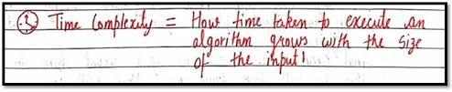
How to analyze time complexity:
Time complexity estimates the time to run an algorithm.
It's calculated by counting elementary operations.

Slide 10
Time Complexity: Example 1
 | Statements | S/E | Freq. | Total
1 | Algorithm Sum(a[],n) { S =0.0; for i=1 to n do s=s+a[i]; return s; } | 0 | - | 0
2 |  | 0 | - | 0
3
 |  | 1 | 1 | 1
4
 |  | 1 | n+1 | n+1
5
 |  | 1 | n | n
6
 |  | 1 | 1 | 1
7 |  | 0 | - | 0
 |  |  |  | 2n+3

Slide 11
Time Complexity: Example 2
 | Statements | S/E | Freq. | Total
1 | Algorithm Sum(a[],n,m) { for i=1 to n do forj=1 to m do s = s+a[i][j]; return s; } | 0 | - | 0
2 |  | 0 | - | 0
3 |  | 1 | n+1 | n+1
4
 |  | 1 | n(m+1) | n(m+1)
5
 |  | 1 | nm | nm
6
 |  | 1 | 1 | 1
7 |  | 0 | - | 0
 |  |  |  | 2nm+2n+2

Slide 12
Time Complexity
int n;
cin >> n;
if (n<1000)
for (int i=0; i<n; i++) for (int j=0; j<n; j++)
for (int k=0; k<n; k++)
cout << "Hello\n";
else
for (int j=0; j<n; j++) for (int k=0; k<n; k++)
cout << "world!\n";

Slide 13
Our Position on Complexity Analysis
Generally speaking, we will use the worst-case complexity as our preferred measure of algorithm efficiency.
Worst-case analysis is generally easy to do, and “usually” reflects the average case. Assume I am asking for worstcase analysis unless otherwise specified!

Slide 14
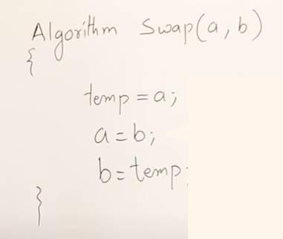
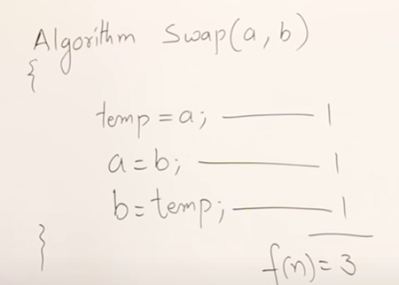
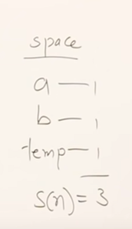
How to analyze an algorithm?

Slide 15
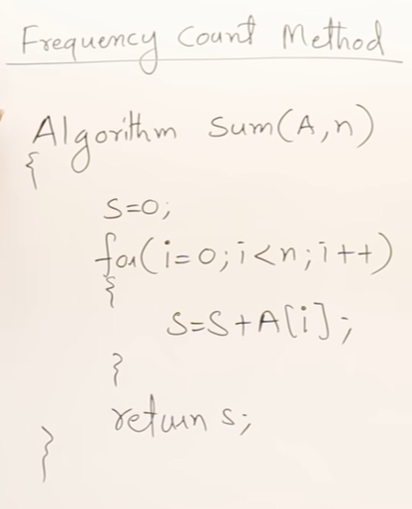
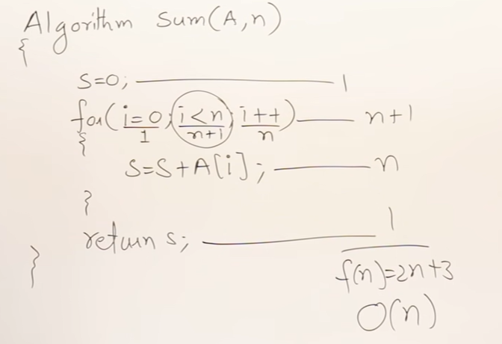
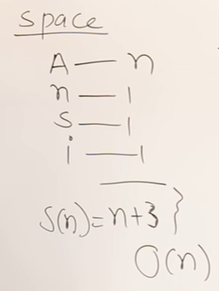
Frequency Count Method
Algo:Sum of array elements

Slide 16
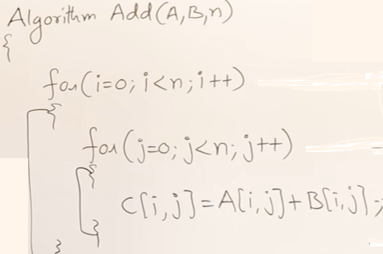
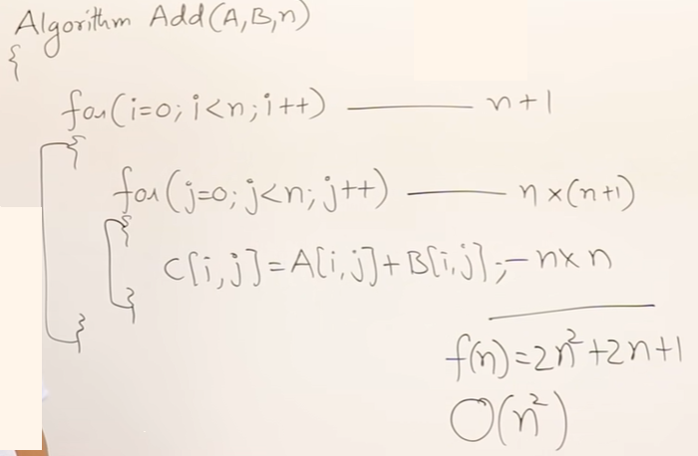
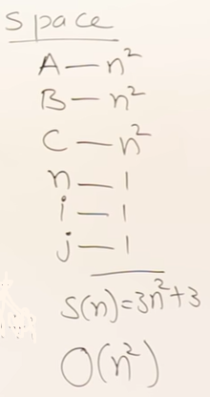
Matrix Addition

Slide 17
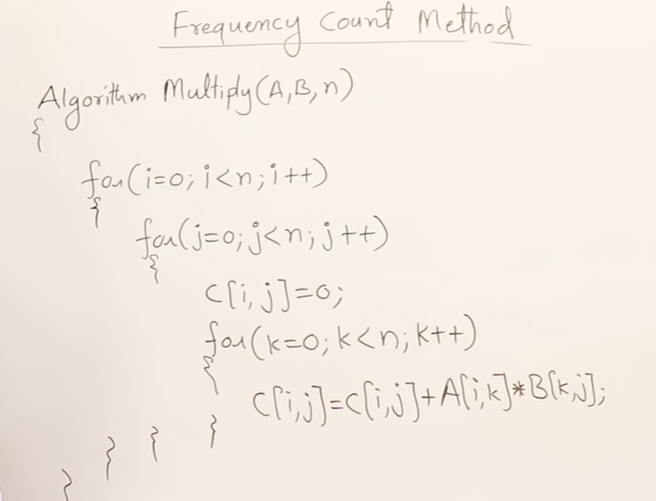
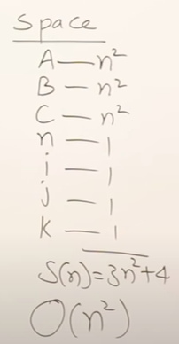
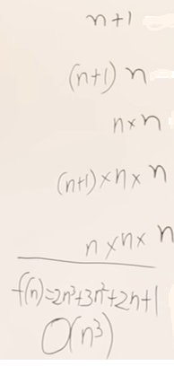
Matrix Multiplication

Slide 18
Example 1:
for(i=0;i<n;i++)
{
Stmt;
}
Example 2:
for(i=1;i<n;i=i+2)
{
Stmt;
}

Slide 19
Time Complexity
int n;
cin >> n;
if (n<1000)
for (int i=0; i<n; i++)
for (int j=0; j<n; j++)
for (int k=0; k<n; k++)
cout << "Hello\n";
else
for (int j=0; j<n; j++)
for (int k=0; k<n; k++)
cout << "world!\n";

Slide 20
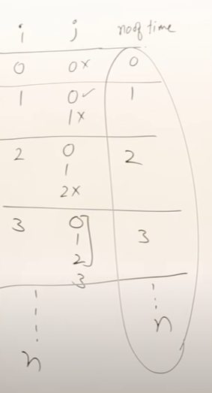
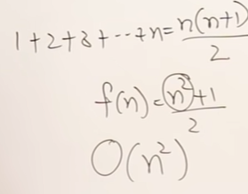
No. of times stmt is executed for various values of i.
Example 3:
for(i=0; i<=n; i++)
{
for(j=0; j<i; j++)
{
Stmt;
}
}

Slide 21
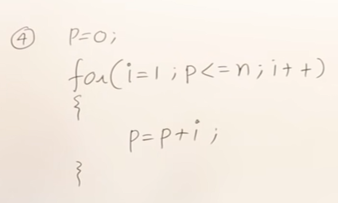
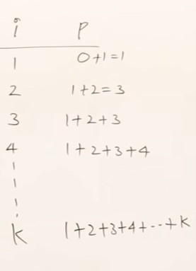
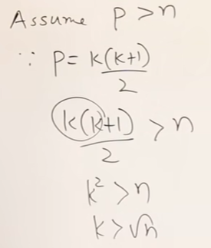
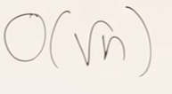

Slide 22
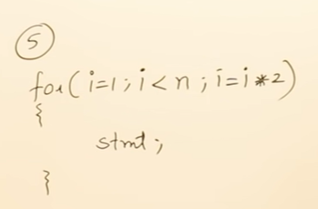
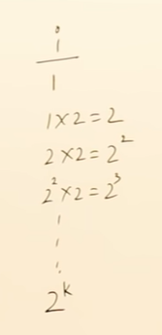
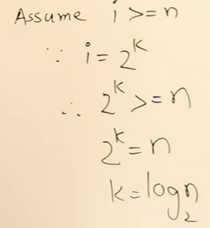
O(log n)

Slide 23
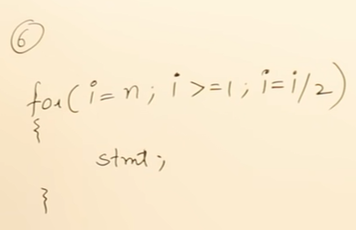
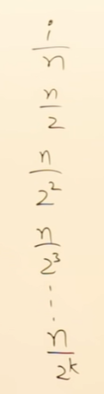
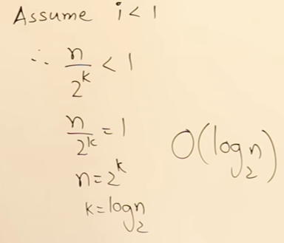
In the for loop if I increment i as i=i/3 what will be O(f(n))?
Base of Log will be 3.

Slide 24
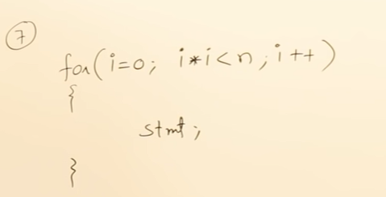
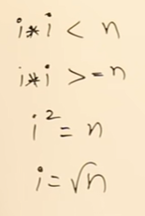

Slide 25
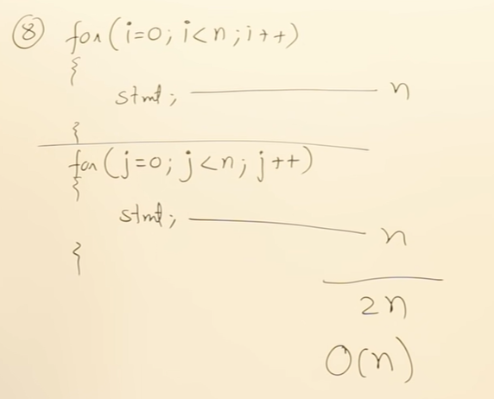
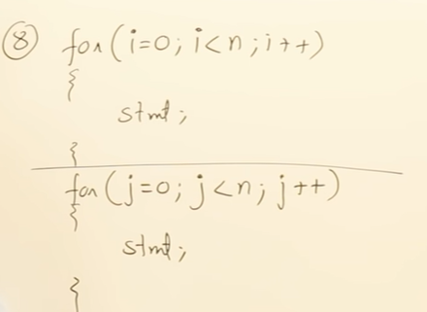
Independent loops

Slide 26
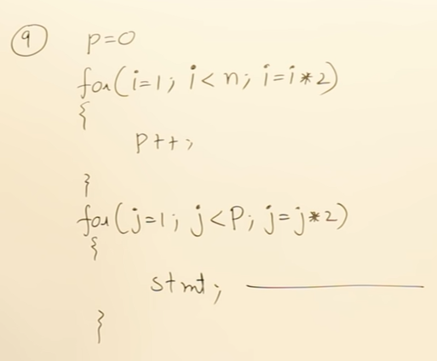
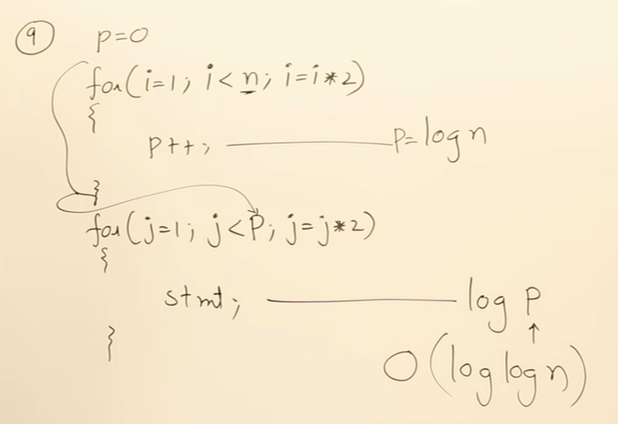
Independent loops

Slide 27
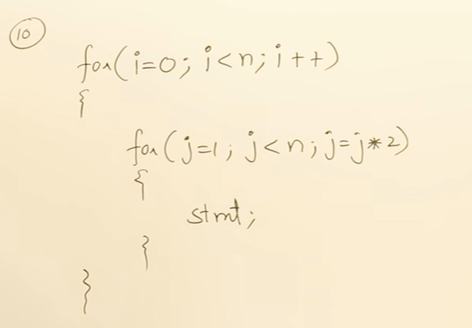
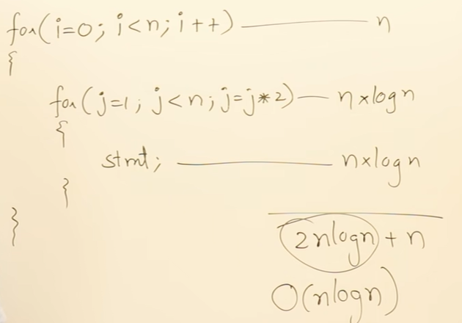

Slide 28
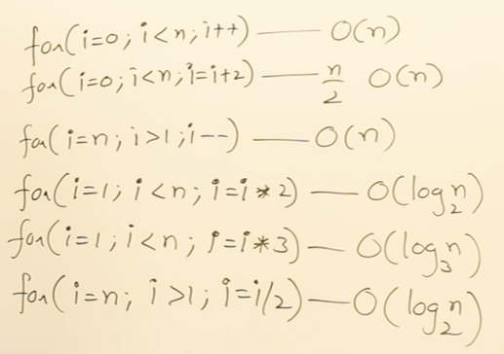
Summary

Slide 29
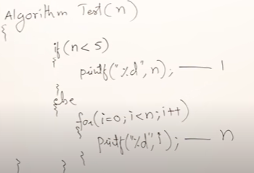
Best Case: O(1)
Worst Case: O(n)

Slide 30
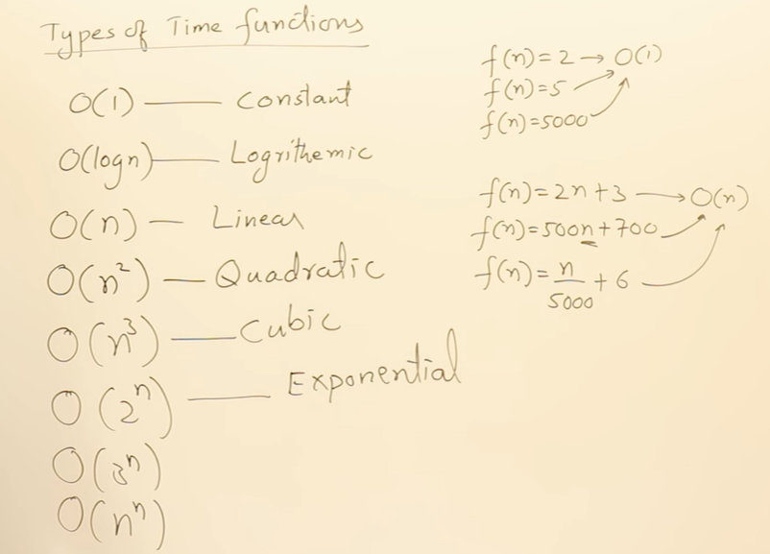
Types/Classes of functions

Slide 31
Compare class of functions

Slide 32
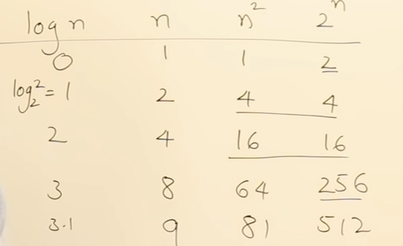
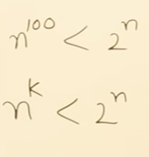
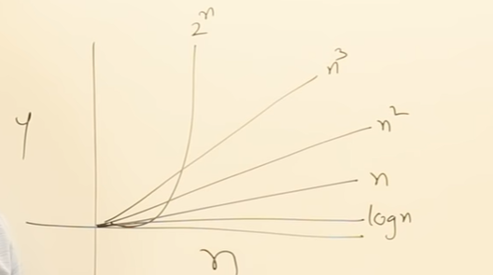
Compare class of functions
Proof:
For larger value of n, at some point n¹⁰⁰ will be smaller than 2^{n}. And from that point onwards 2^{n} will be always greater. So there will be some starting value of n from which that will be always greater.

Slide 33
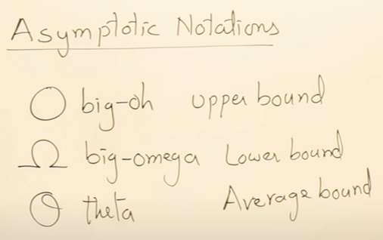
Asymptotic Notations
Which one is useful?

Slide 34
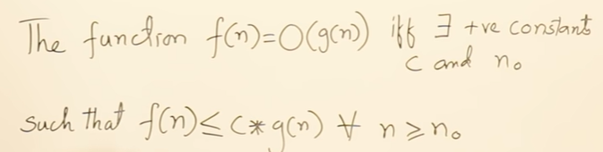
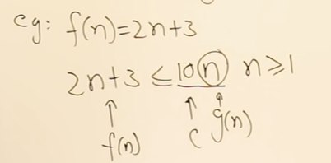
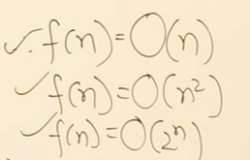
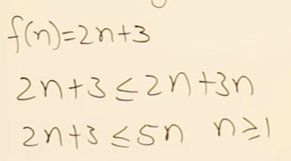
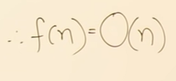

Asymptotic Notations- Big Oh –O (Upper bound)
As f(n) belongs to class of n,
all functions >= f(n) becomes UB of it.
All functions <= f(n) becomes lower bound and
n becomes average bound for f(n)
Simple method to select the term on RHS of <= is:

Slide 35
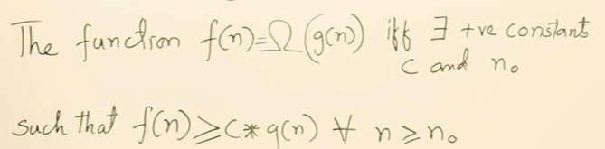
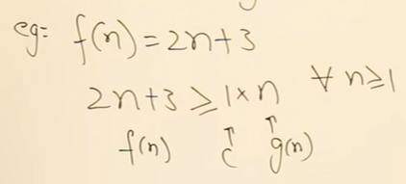
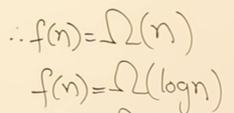


Asymptotic Notations- Big Omega - Ω
As f(n) belongs to class of n,
all functions >= f(n) becomes UB of it.
All functions <= f(n) becomes lower bound and
n becomes average bound for f(n)

Slide 36
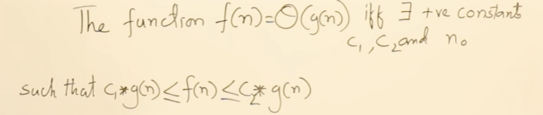
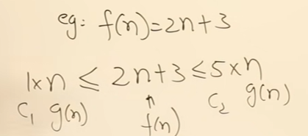

Asymptotic Notations- Theta - θ
As f(n) belongs to class of n,
all functions >= f(n) becomes UB of it.
All functions <= f(n) becomes lower bound and
n becomes average bound for f(n)
IMP: Never relate notations to Best, average and worst cases.
Notations just represent bounds of the time function

Slide 37
Examples on Asymptotic Notations (Pg. 18-19 Dec)
Represent following functions using asymptotic notations
f(n) = 2n² + 3n + 4
f(n) = n²log n + n
f(n) = n!
f(n) = log n!

Slide 38
Properties of Asymptotic Notations
1. General Properties :
If f(n) is O(g(n)) then a*f(n) is also O(g(n)) ; where a is a constant.
Example: f(n) = 2n²+5 is O(n²) then 7*f(n) = 7(2n²+5) = 14n²+35 is also O(n²) .
Similarly this property satisfies for both Θ and Ω notation.
We can say If f(n) is Θ(g(n)) then a*f(n) is also Θ(g(n)) ; where a is a constant. If f(n) is Ω (g(n)) then a*f(n) is also Ω (g(n)) ; where a is a constant.

Slide 39
Properties of Asymptotic Notations
2. Transitive Properties :
If f(n) is O(g(n)) and g(n) is O(h(n)) then f(n) = O(h(n)) .
Example: if f(n) = n, g(n) = n² and h(n)=n³ n is O(n²) and n² is O(n³) then n is O(n³)
Similarly this property satisfies for both Θ and Ω notation.
We can say If f(n) is Θ(g(n)) and g(n) is Θ(h(n)) then f(n) = Θ(h(n)) . If f(n) is Ω (g(n)) and g(n) is Ω (h(n)) then f(n) = Ω (h(n))

Slide 40
Properties of Asymptotic Notations
3. Reflexive Properties :
If f(n) is given then f(n) is O(f(n)).
Any function f(n) is upper bound of itself.
Example: f(n) = n² ; O(n²) i.e O(f(n))
Similarly this property satisfies for both Θ and Ω notation.
We can say that:
If f(n) is given then f(n) is Θ(f(n)).
If f(n) is given then f(n) is Ω (f(n)).

Slide 41
Properties of Asymptotic Notations
4. Symmetric Properties :
If f(n) is Θ(g(n)) then g(n) is Θ(f(n)) .
Example: f(n) = n² and g(n) = n² then f(n) = Θ(n²) and g(n) = Θ(n²)
This property only satisfies for Θ notation.
5. Transpose Symmetric Properties :
If f(n) is O(g(n)) then g(n) is Ω (f(n)).
Example: f(n) = n , g(n) = n² then n is O(n²) and n² is Ω (n)
This property only satisfies for O and Ω notations.

Slide 42
Properties of Asymptotic Notations
6. Some More Properties :
1.) If f(n) = O(g(n)) and f(n) = Ω(g(n)) then f(n) = Θ(g(n))
2.) If f(n) = O(g(n)) and d(n)=O(e(n)) then f(n) + d(n) = O( max( g(n), e(n) )) Example: Let f(n) = n i.e O(n) and d(n) = n² i.e O(n²) then f(n) + d(n) = n + n² i.e O(n²)
3.) If f(n)=O(g(n)) and d(n)=O(e(n)) then f(n) * d(n) = O( g(n) * e(n) ) Example: Let f(n) = n i.e O(n) and d(n) = n² i.e O(n²) then f(n) * d(n) = n * n² = n³ i.e O(n³)

Slide 43
Analysis of algorithm using Asymptotic analysis
We can have three cases to analyse an algorithm: 1) Worst Case Analysis (Usually Done) In the worst case analysis, we calculate upper bound on running time of an algorithm. We must know the case that causes maximum number of operations to be executed.
2) Average Case Analysis (Sometimes done)
In average case analysis, we take all possible inputs and calculate computing time for all of the inputs. Sum up all the calculated values and divide the sum by total number of inputs. We must know (or predict) distribution of cases.
3) Best Case Analysis (Bogus)
In the best case analysis, we calculate lower bound on running time of an algorithm. We must know the case that causes minimum number of operations to be executed.

Slide 44
Best, Worst and Average case analysis 1. Linear Search 2. Binary Search Tree

Slide 45
Analysis of Linear search using Asymptotic analysis
int search(int arr[], int n, int x)
{
int i;
for (i = 0; i < n; i++) {
if (arr[i] == x)
return i;
}
return -1;
}
Worst Case Analysis (Usually Done) For Linear Search, the worst case happens when the element to be searched (x in the above code) is not present in the array. When x is not present, the search() functions compares it with all the elements of arr[] one by one. Therefore, the worst case time complexity of linear search would be O(n).
Average Case Analysis (Sometimes done) For the linear search problem, the average case time will be average of search time when key to be searched is at position 1,2,3,4……n.
So average case time= (1+2+3+4……..+n)/n = n(n+1)/2n = (n+1)/2 i.e Θ(n).

Slide 46
Analysis of Linear search using Asymptotic analysis
int search(int arr[], int n, int x)
{
int i;
for (i = 0; i < n; i++) {
if (arr[i] == x)
return i;
}
return -1;
}
Best Case Analysis (Bogus) In the linear search problem, the best case occurs when x is present at the first location. The number of operations in the best case is constant (not dependent on n). So time complexity in the best case would be Ω (1)
Most of the times, we do worst case analysis to analyze algorithms. In the worst analysis, we guarantee an upper bound on the running time of an algorithm which is good information.
The average case analysis is not easy to do in most of the practical cases and it is rarely done. In the average case analysis, we must know (or predict) the mathematical distribution of all possible inputs.
The Best Case analysis is bogus. Guaranteeing a lower bound on an algorithm doesn’t provide any information as in the worst case, an algorithm may take years to run.

Slide 47






Analysis of Binary search using Asymptotic analysis
Height balanced BST : Height=logn
Left Skewed BST: height=n

